Slide 1
UNIT V INFORMATION THEORY
Dr.M.Manimegalai, ASP, ECE
GCE, Bargur

Slide 2
📡 Information Theory in Communication Systems
Information Theory is the mathematical foundation that tells us how information is measured, transmitted, compressed, and protected against noise in a communication system. It answers a core question:
What is the maximum amount of information that can be sent reliably over a channel?
🔷 Why Information Theory is Needed
In real communication systems:
Signals are corrupted by noise
Bandwidth and power are limited
Errors cannot be avoided completely
Information theory helps us:
Quantify information content
Determine maximum achievable data rate
Design efficient coding and modulation schemes
Analyze error performance limits

Slide 3
🔹 Information Source
📌 Definition
An information source is the origin of the message in a communication system.
It produces symbols or messages that convey information to be transmitted.
👉 In simple words: Information source = where the message comes from
🔹 Discrete Memoryless Source (DMS)
A Discrete Memoryless Source (DMS) is an information source that:
Produces discrete symbols
Has no memory of past symbols
Generates each symbol independently with fixed probabilities
👉 The probability of the current symbol does not depend on previous symbols.

Slide 4
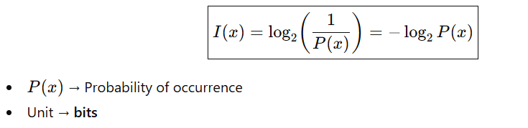
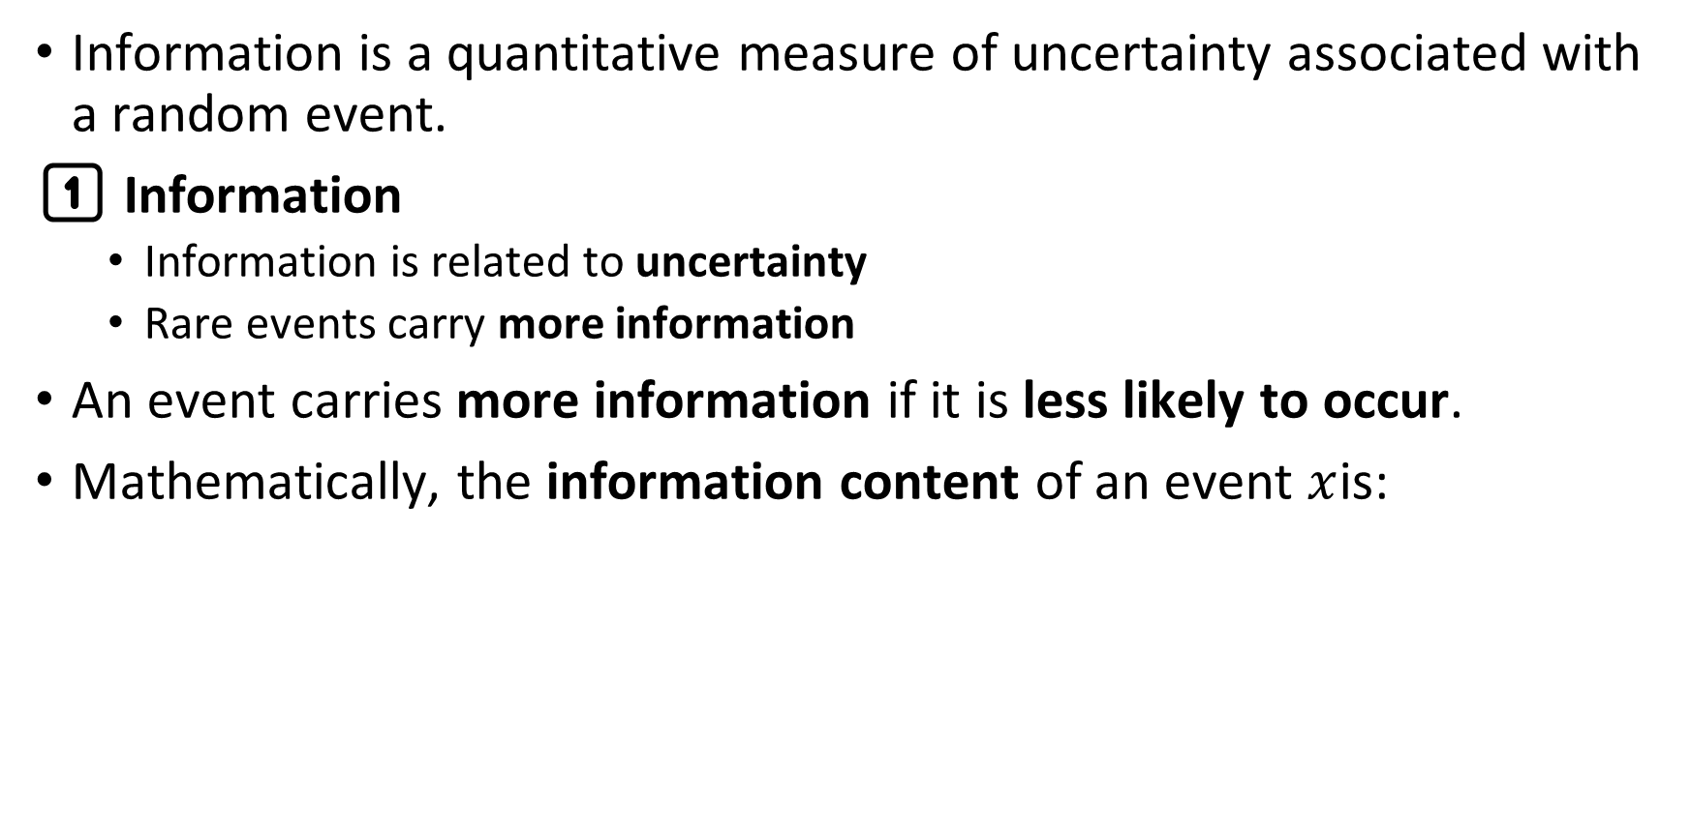
What is Information
Information is a quantitative measure of uncertainty associated with a random event.
1️⃣ Information
Information is related to uncertainty
Rare events carry more information
An event carries more information if it is less likely to occur.
Mathematically, the information content of an event $x$is:

Slide 5
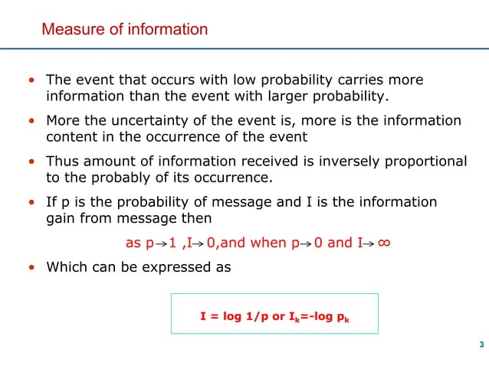

Slide 6
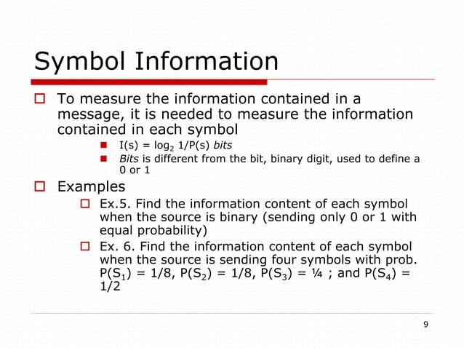

Slide 7
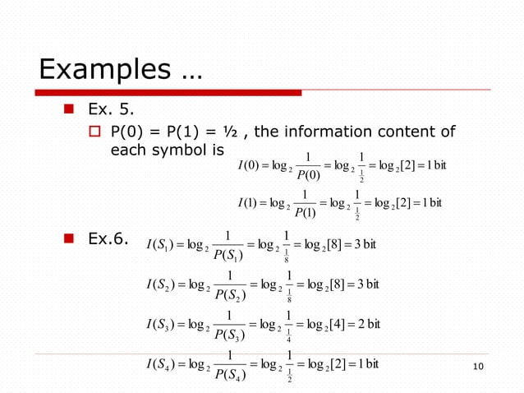

Slide 8
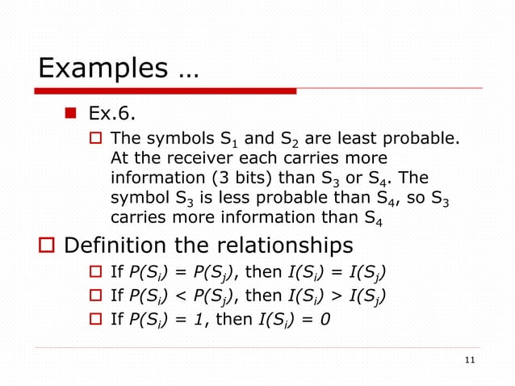

Slide 9
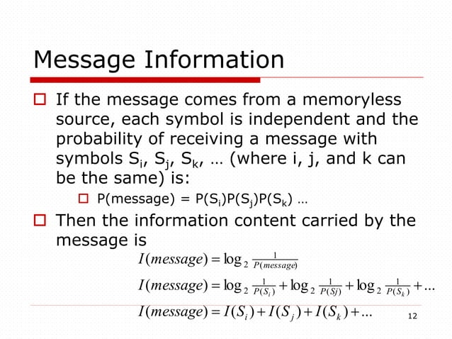

Slide 10
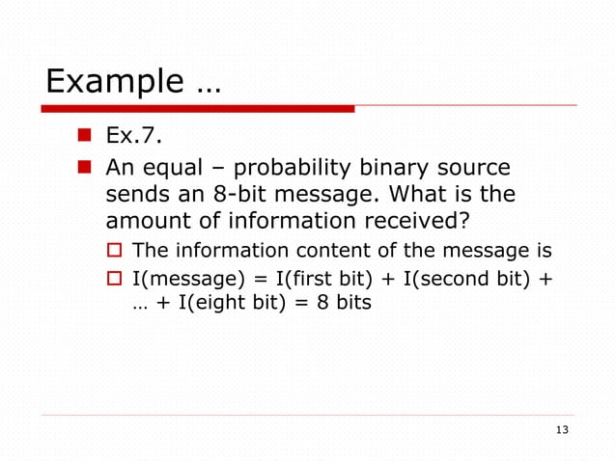

Slide 11
🔹 Entropy (H)
📌 Definition
Entropy is the average amount of information produced by an information source. It measures the uncertainty or randomness of the source.
👉 More uncertainty → higher entropy 👉 More predictability → lower entropy

Slide 12
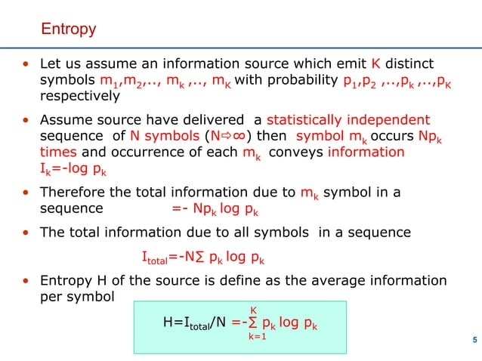

Slide 13
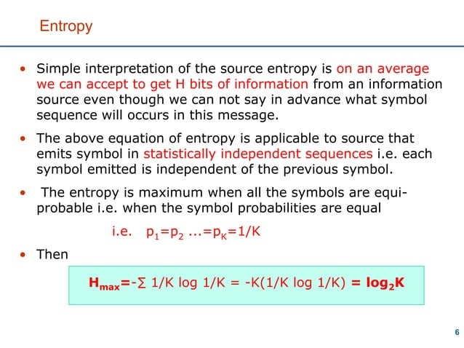

Slide 14
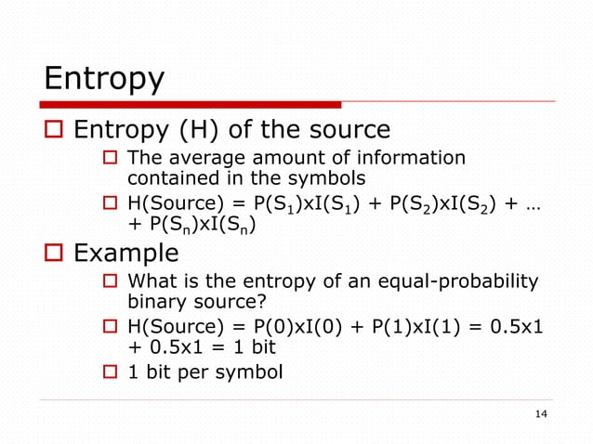

Slide 15
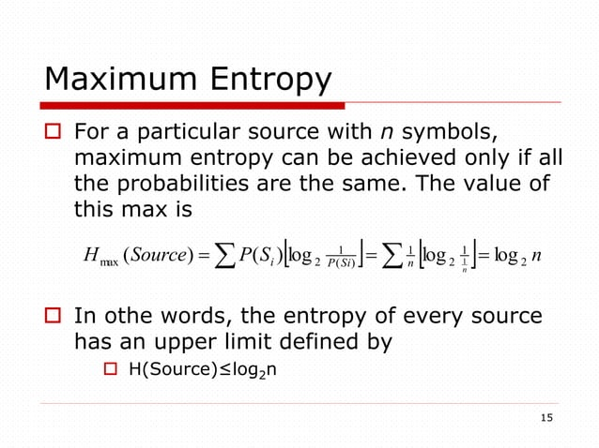

Slide 16
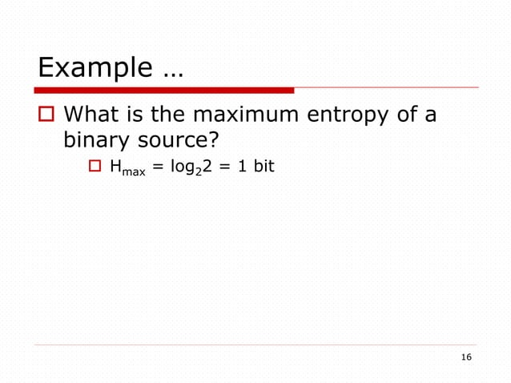

Slide 17
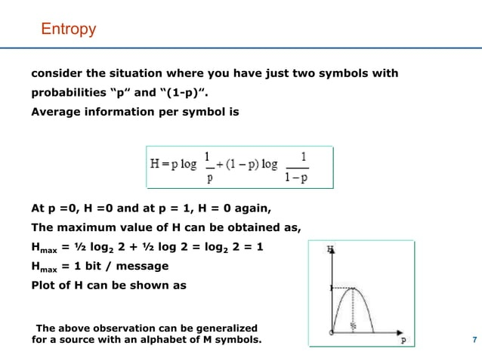

Slide 18
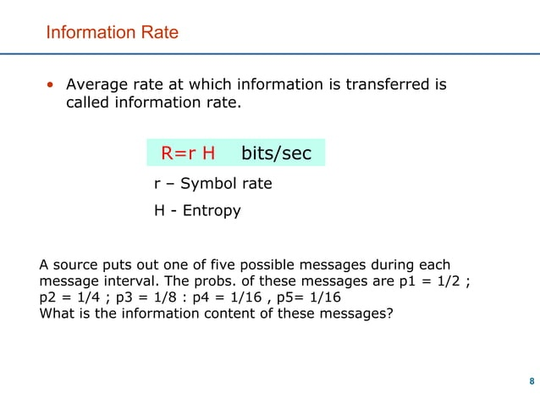

Slide 19
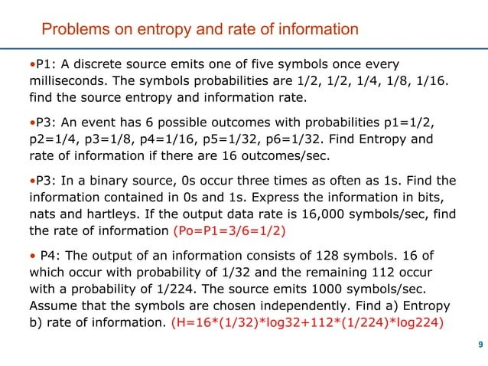

Slide 20
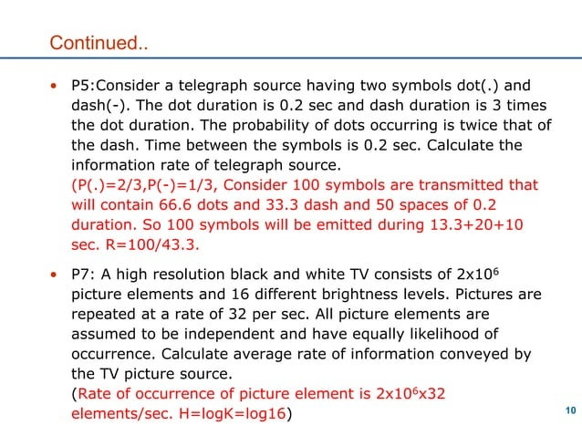

Slide 21
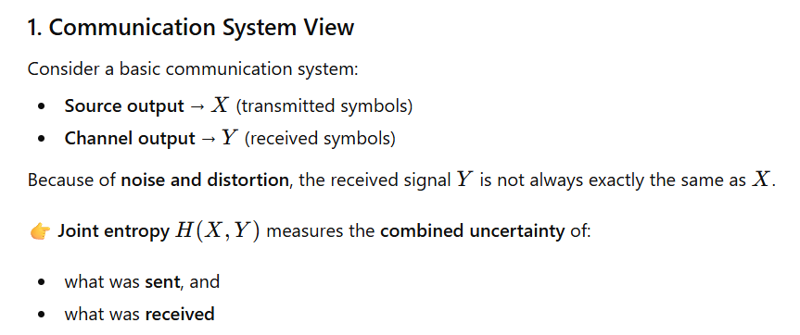
Joint Entropy
In a communication system, joint entropy explains how much total information (or uncertainty) is associated with the transmitted message and the received message taken together.

Slide 22
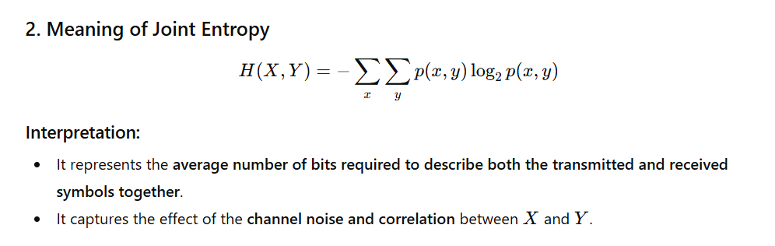

Slide 23
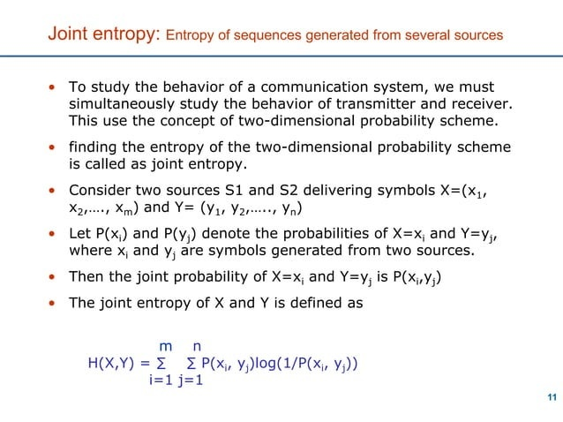

Slide 24
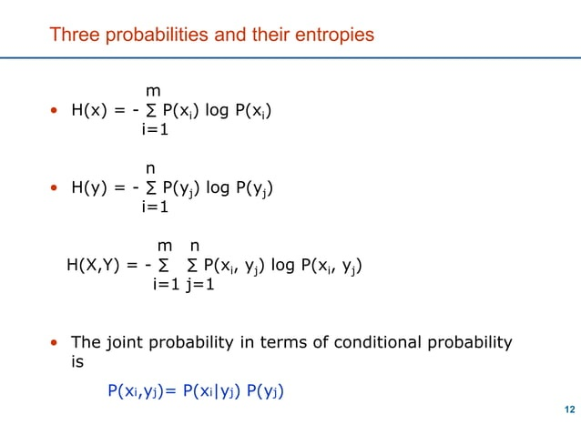

Slide 25
Conditional Entropy
Conditional entropy measures the average uncertainty remaining in one random variable when another random variable is known.

Slide 26
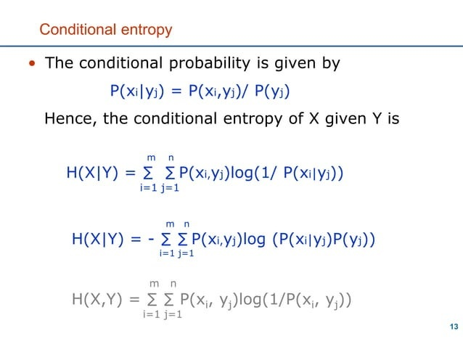

Slide 27
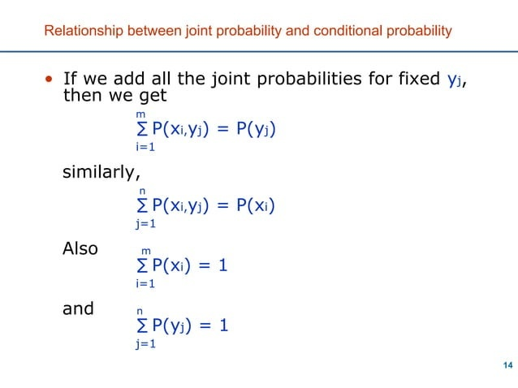

Slide 28
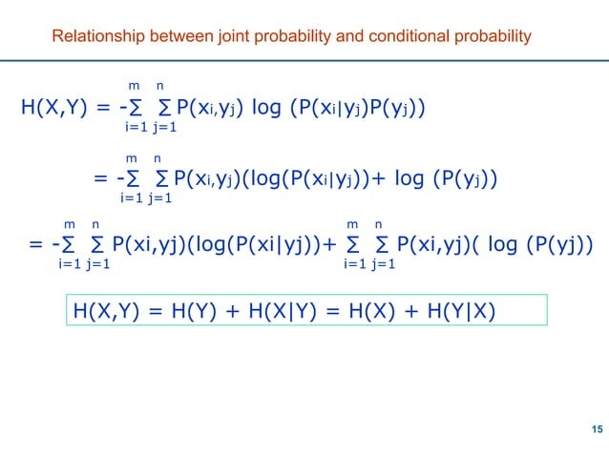

Slide 29
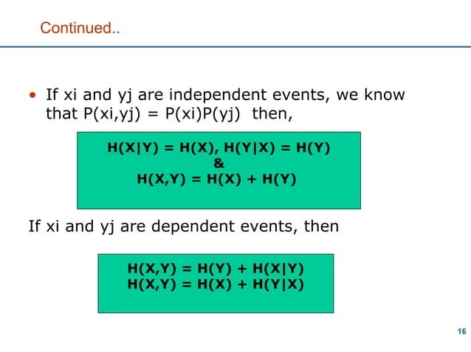

Slide 30
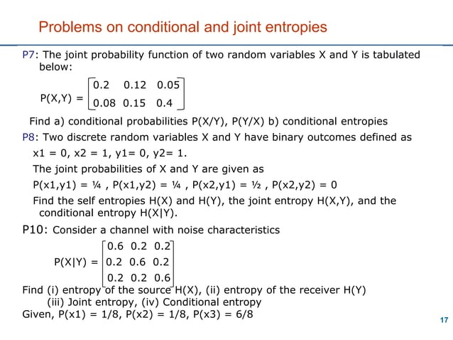

Slide 31
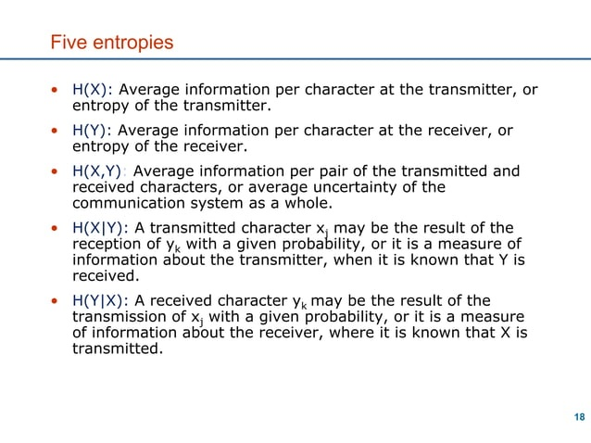

Slide 32
